Slide 1
Health Insurance
Protecting your health, securing your future.
TEAM MEMBERS
1. Prachi Jain
2. Diana Caroline
3. S.Neha
4. R V Varsha
5. Ch.Sai Kanaka Sireesha
Mentor – P.V Subramanian

Slide 2
DOMAIN
In the realm of insurance, the medical domain is a crucial
sector that focuses on providing coverage and financial
protection against healthcare expenses. It
encompasses various types of insurance plans
designed to assist individuals and families in
managing the costs associated with medical care,
including preventive services, treatment for
illnesses and injuries, prescription medications,
and hospitalization.

Slide 3
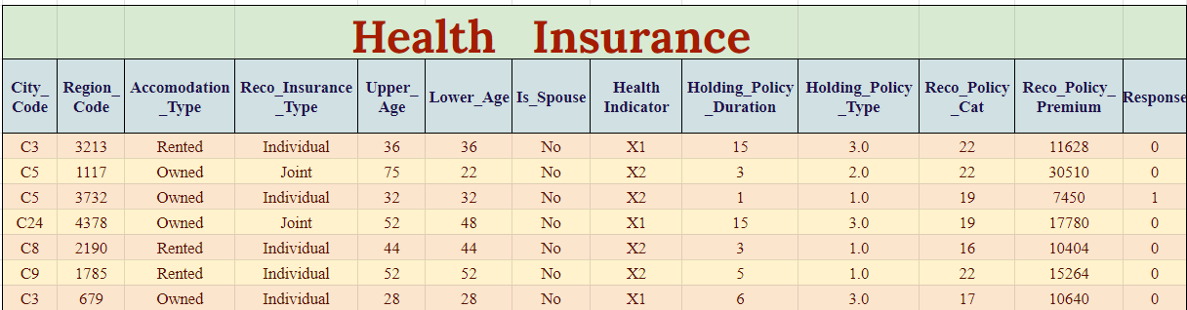
PROBLEM STATEMENT
To develop a predictive model that accurately predicts who are likely to show interest in the recommended policy based on their demographic and policy-related attributes. This model aims to optimize the marketing efforts of the insurance company by targeting individuals who are more likely to subscribe to the recommended policy. Ultimately, the goal is to increase the conversion rate of policy recommendations, leading to higher sales and revenue for the insurance company while also providing suitable insurance coverage to interested individuals.

Slide 4
DATA INFORMATION
Variable | Datatype
ID | int
Region_Code | int
Upper_Age | int
Lower_Age | int
Holding_Policy_Type | float
Reco_Policy_Cat | int
Reco_Policy_Premium | float
Response | int
Features – 14
Rows – 50882
Categorical Features – 6
Numeric Features – 8
Variable | Datatype
City_Code | object
Accomodation_Type | object
Reco_Insurance_Type | object
Is_Spouse | object
Health Indicator | object
Holding_Policy_Duration | object

Slide 5
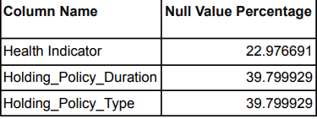
DATA PREPROCESSING
Missing Value Treatment
The missing value treatment used is a form of random imputation
for the variables: ‘Health_Indicator’, ‘Holding_Policy_Duration’
and ‘Holding_Policy_Type’. This approach involves replacing
missing values in the variable with randomly selected values
from the existing categories, weighted by their respective
proportions in the dataset.

Slide 6
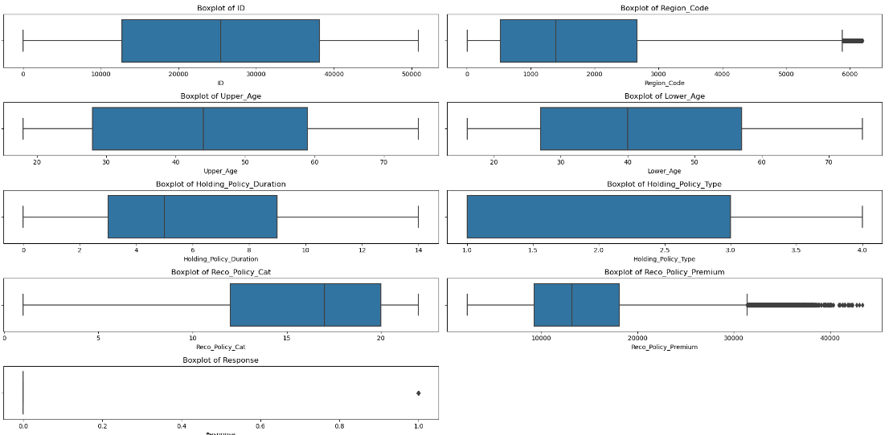
Check for Outliers
The variables ‘Region_Code’ and ‘Reco_Policy_Premium’ exhibit outliers, yet we choose not to address
them, as doing so could result in the loss of valuable data and potentially compromise the efficacy of
our modeling
approach.

Slide 7
Encoding
Frequency Encoding for City Code
One-Hot Encoding for Accomodation_type and
Reco_Insurance_Type

Slide 8
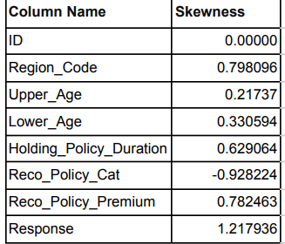
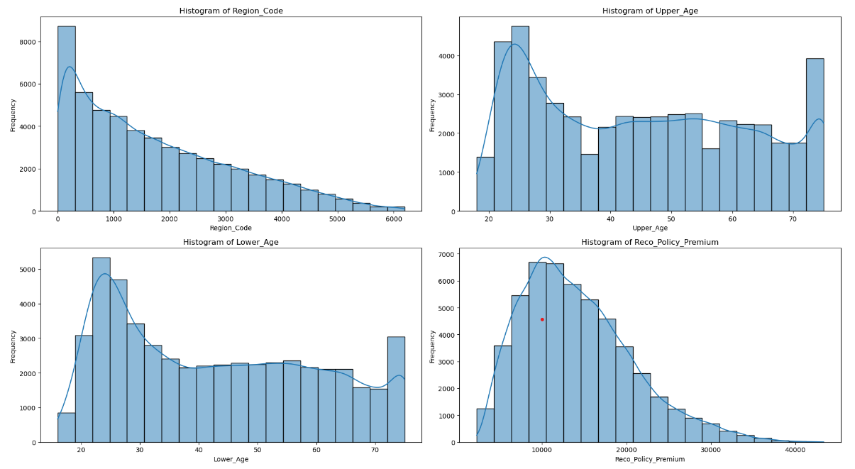
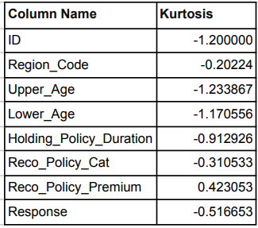
Exploratory Data Analysis (EDA)
Univariate Analysis

Slide 9
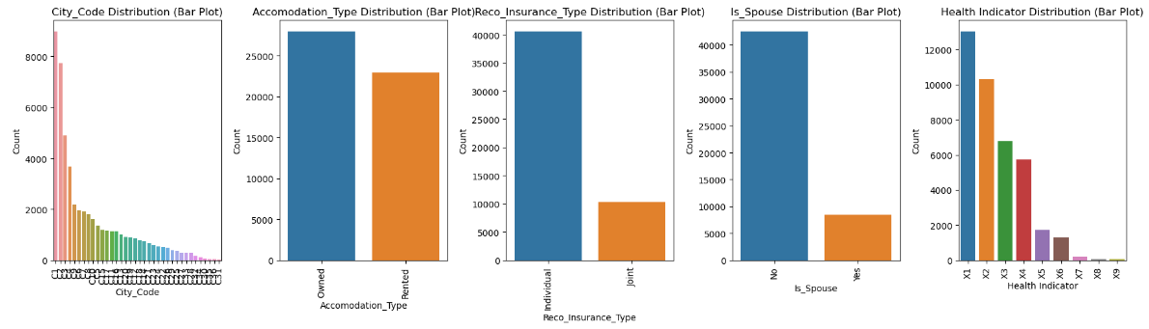
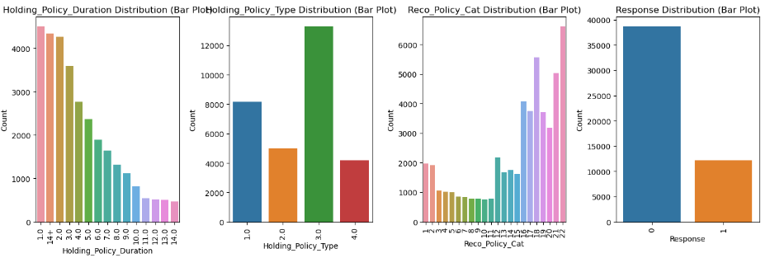

Slide 10
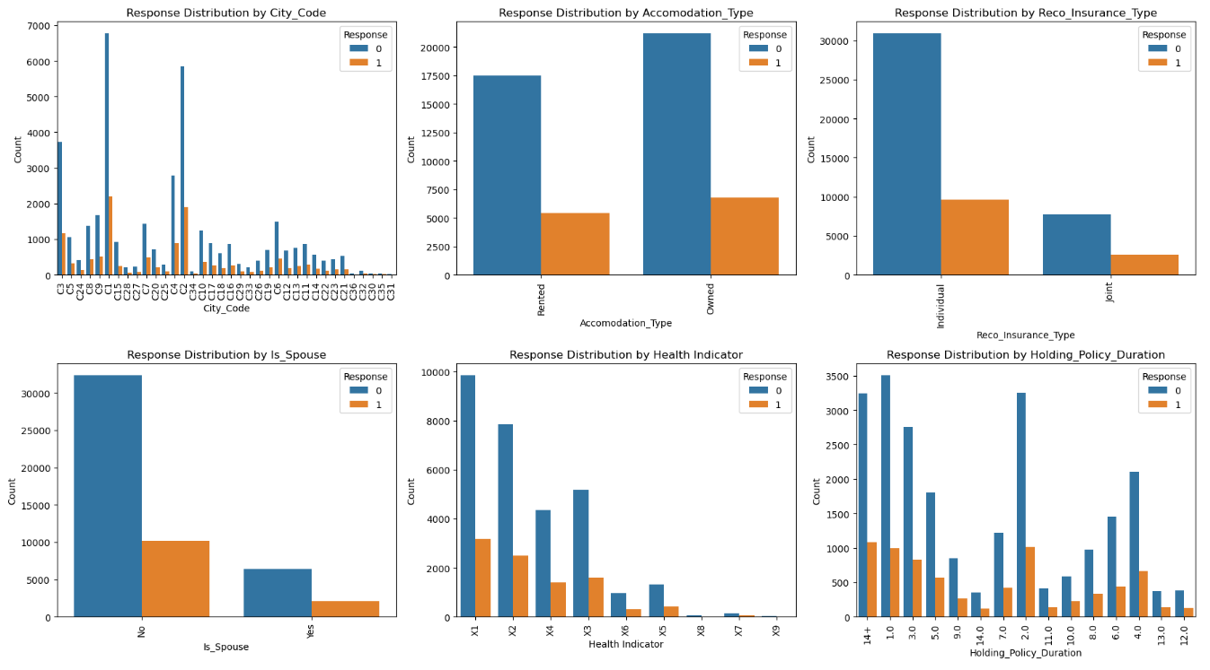
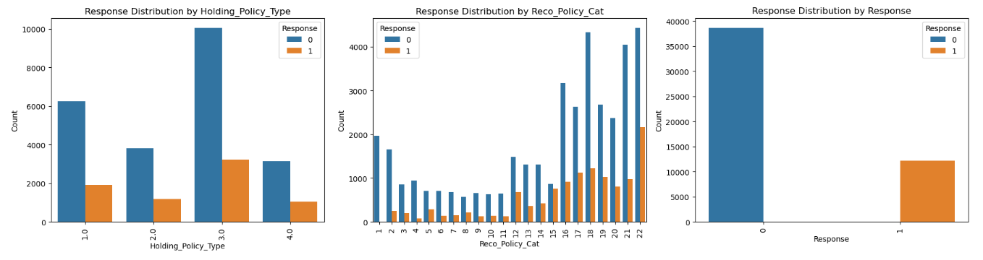
Bi-Variate Analysis

Slide 11
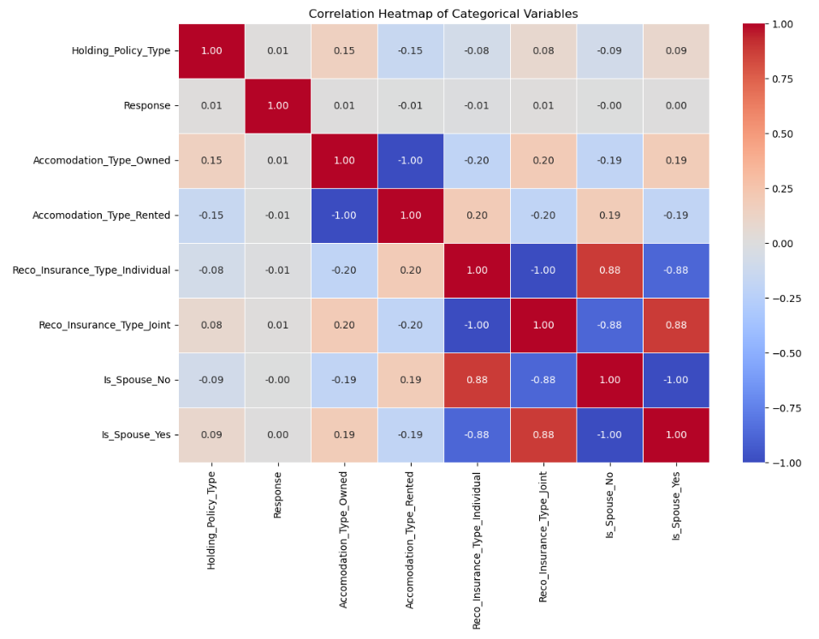
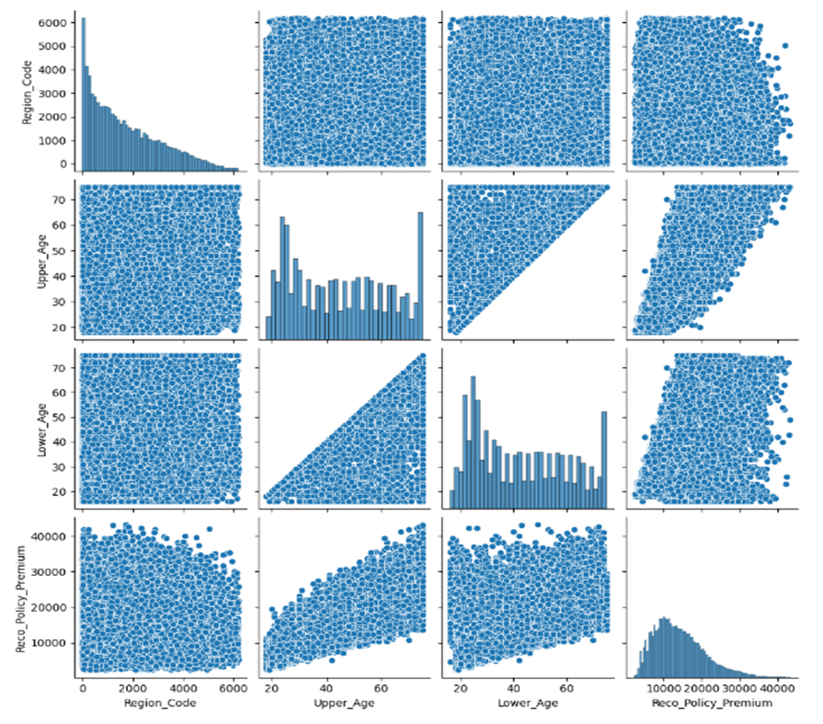
Multi-Variate Analysis

Slide 12
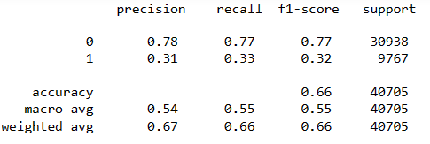
BASE MODEL
Decision Tree – Before Pruning
Confusion Matrix
Classification Report
ACTUAL 0
23780
7158
ACTUAL 1
6596
3171
Mean Recall: 0.33132078795912545
Mean Precision: 0.3108105591054072
Mean Accuracy: 0.6631371956132457
Mean ROC-AUC Score: 0.5488212515286655
Mean F1 Score: 0.3167199211195349
PREDICTED 0
PREDICTED 1

Slide 13
BASE MODEL
Decision Tree – After Pruning
Confusion Matrix
Classification Report
ACTUAL 0
23805
7133
ACTUAL 1
6592
3175
Mean Recall: 0.322882298186150304
Mean Precision: 0.31054744312199933
Mean Accuracy: 0.6643903755031243
Mean ROC-AUC Score: 0.5480540059020755
Mean F1 Score: 0.3181409223166014
PREDICTED 0
PREDICTED 1

Slide 14
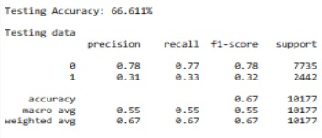
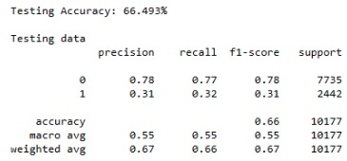
BASE MODEL
Decision Tree
Test Confusion Matrix – Before Pruning
Test Confusion Matrix – After Pruning
A 0
5981
1754
A 0
5985
1750
A 1
1644
798
A 1
1660
782
P 0
P 1
P 0
P 1
Classification Report – Before Pruning
Classification Report – After Pruning

Slide 15
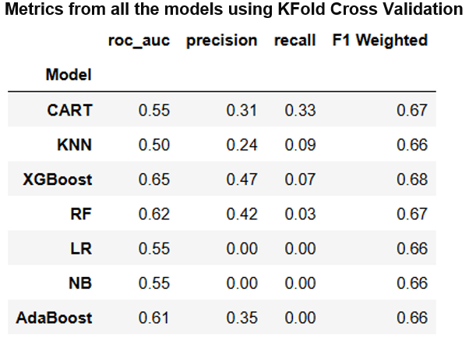
Improving The Models
K-Fold Cross Validation: K-fold cross-validation is a popular technique used in machine learning to assess the performance and generalizability of a model. It involves partitioning the dataset into K equally sized subsets or "folds" then trained and validated.

Slide 16
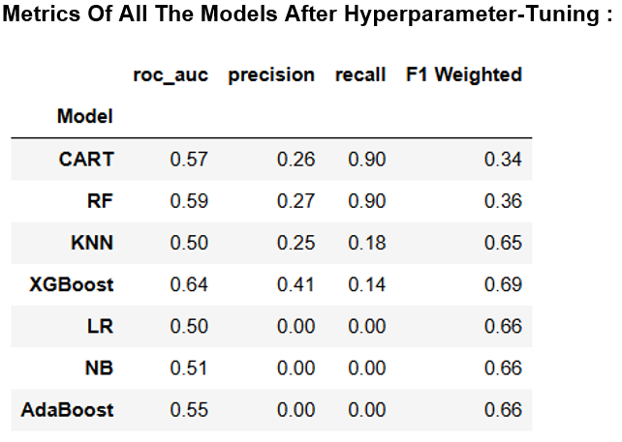
Hyper parameter tuning : Hyperparameter tuning is the process of optimizing the hyperparameters of a machine learning model to improve its performance. Hyperparameters are the settings or configurations that are not learned from the data but are set before the training process begins.

Slide 17
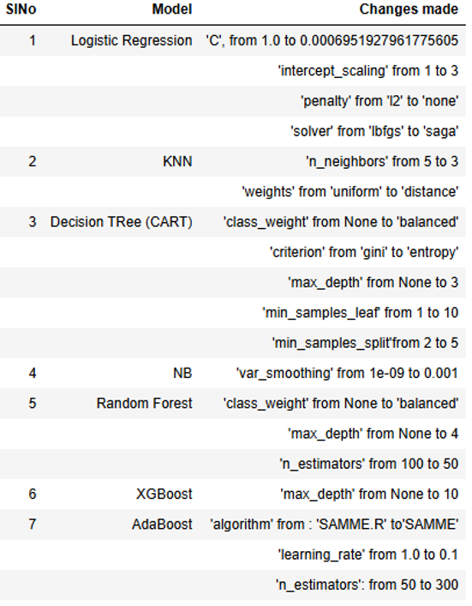
Evaluating the Tuned Models:

Slide 18
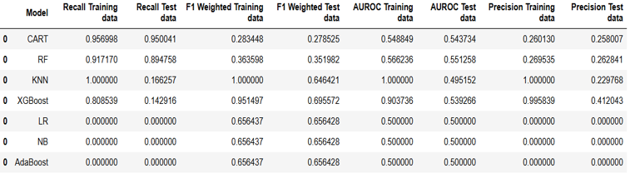
Models with SMOTE:SMOTE (Synthetic Minority Over-sampling Technique) is an algorithm used to address class imbalance in datasets, particularly for binary classification problems. It helps to increase the number of instances in the minority class by generating synthetic samples, thereby balancing the dataset and improving the performance of machine learning models.

Slide 19
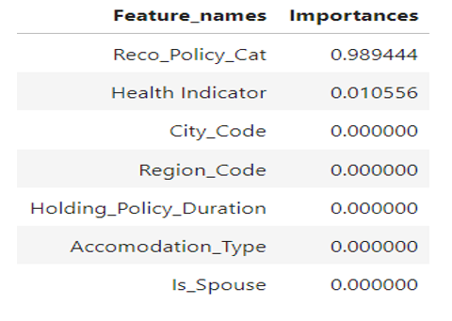
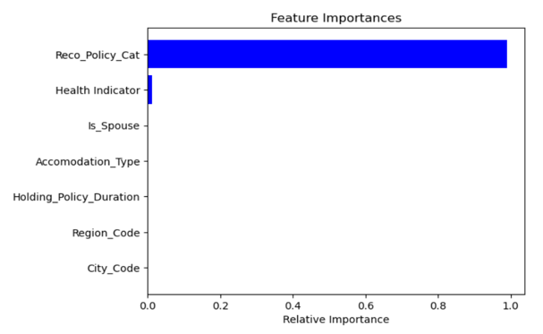
FEATURE IMPORTANCES
VARIABLE IMPORTANCE PLOT

Slide 20
Model's Conclusion
By selecting the CART model with SMOTE as our final model, we prioritize a
balanced performance that effectively addresses the class imbalance issue.
This choice ensures that our model is robust and reliable, with enhanced
sensitivity to the minority class, thereby improving overall model effectiveness
and generalizability.
In conclusion, the implementation of SMOTE with the CART model not only
improved recall but also provided a balanced and accurate classification
framework suitable for our needs. This approach underscores the importance
of addressing class imbalance in machine learning and highlights the
benefits of using SMOTE in conjunction with robust classification models for
optimal performance.

Slide 21
Project Conclusion
In this project, we applied supervised classification techniques to predict
health insurance status among individuals based on a range of
demographic, socio-economic, and health-related features. The goal was
to develop a robust model that could accurately identify whether an
individual is likely to have health insurance coverage.
The supervised classification project on health insurance prediction
successfully developed a predictive model with high recall and reliability.
The insights gained from feature importance analysis can inform targeted
strategies to improve health insurance coverage. While the model performs
well on the current dataset, continuous monitoring and periodic retraining
with new data will be necessary to maintain its accuracy and relevance.
Future work could involve integrating additional data sources and exploring
advanced techniques such as ensemble learning to further enhance predictive
performance.

Slide 22
Scope for Improvement
To address these challenges, efforts should focus on enhancing data quality through rigorous cleaning, standardization, and incorporation of external data sources. Advanced analytical techniques, including machine learning and AI, offer promise in improving predictive modeling capabilities and interpretability. Collaborative partnerships and interdisciplinary research are essential for fostering innovation and developing solutions that promote equitable access to healthcare, improve patient outcomes, and optimize resource allocation in health insurance systems.

Slide 23

Happy Coding!!!

